Slide 1



Exploratory Data Analysis on Flipkart Mobile Products

Slide 2



About Me
Name : S.GOWTHAM KUMAR
Education : B.A
linkedin.com/in/gowtham-kumar-sirisetti

Slide 3

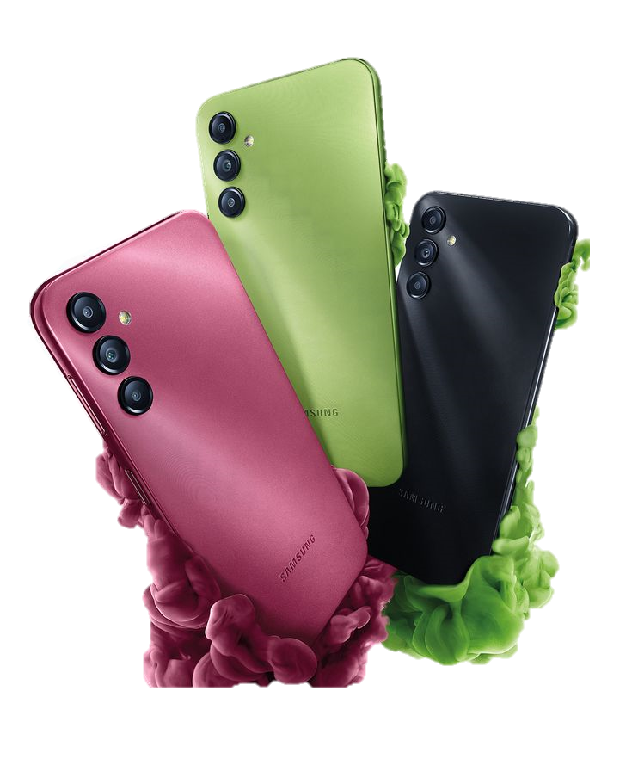

Business Problem
Use Case: Flipkart, like any e-commerce platform, hosts hundreds of mobile phones. Customers often struggle to compare and make informed buying decisions. Businesses, on the other hand, need data-backed insights to optimize listings and pricing.
Business Problem: Customers lack a comparative view across product features, prices, and reviews. Flipkart and sellers need insights into what product features drive customer interest and value.

Slide 4


Objective of the Project
To scrape smartphone data from Flipkart.
To perform Exploratory Data Analysis (EDA) and understand the current mobile market trends.
To identify patterns in product ratings, pricing, features like RAM, battery, and camera.
To assist buyers and sellers with data-driven decisions.

Slide 5


Web Scraping Details
Website:
Pages Scraped: 200 pages
Scraped Using: Python with requests, BeautifulSoup, and re (Regex)
Scraped Fields: Product Name, Brand, Ratings & Reviews, Price, Offer, Discount, Screen Size, Camera, Battery, RAM, Model Name and Storage (extracted using Regex)
Process Summary: Iterated through multiple pages using URL pagination.
Parsed HTML structure to extract structured data.
Cleaned and extracted nested information using
regex patterns.

Slide 6

Data Manipulation
Extracted brand, model name, storage capacity from complex product titles.
Converted percentage discounts and price values to numeric.
Created new columns like “Discounted Price”, “Effective Storage”.
Categorized products into price brackets (e.g., <10K, 10K–20K, etc.).
Data Cleaning
Removed missing values or replaced with NaNs.
Cleaned string fields (e.g., ₹ symbols, % signs, special characters).
Converted numerical fields like price, RAM, battery into proper datatypes.
Standardized brand and model naming using regex.

Slide 7
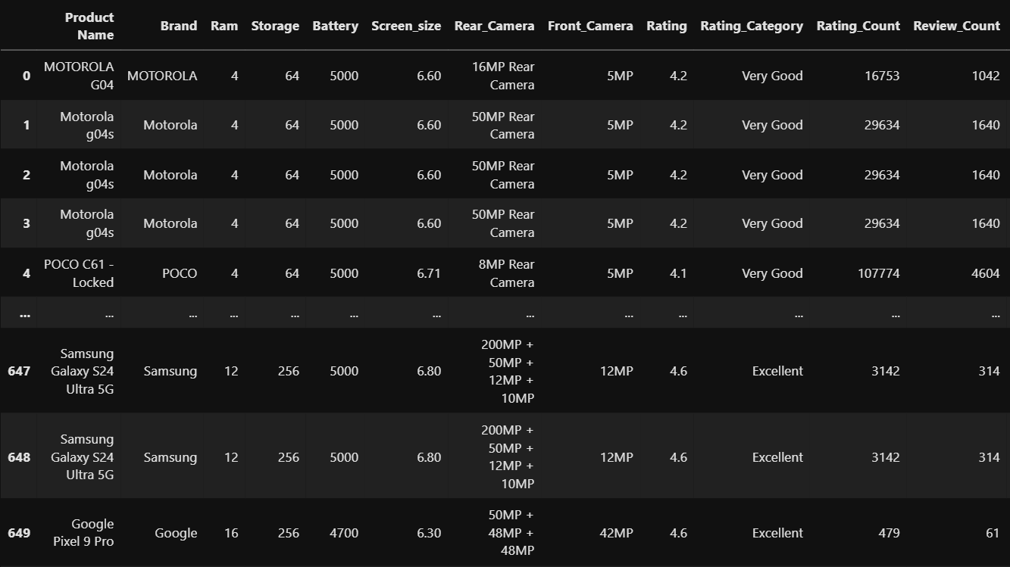
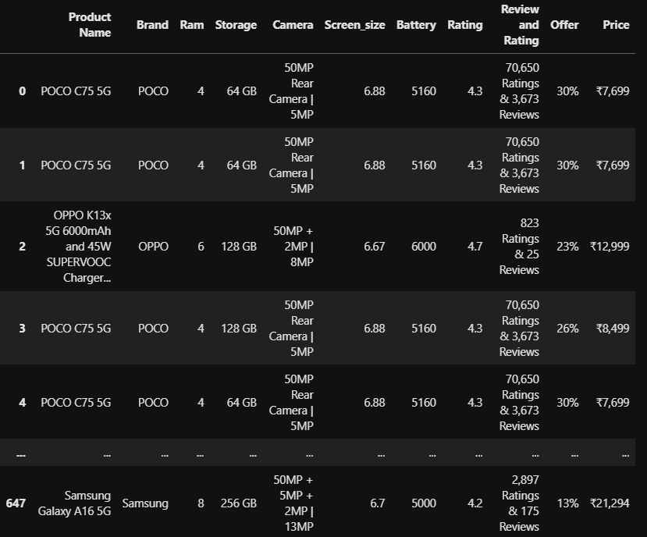
Clean data Frame of the Product
Raw data Frame of the Product

Slide 8
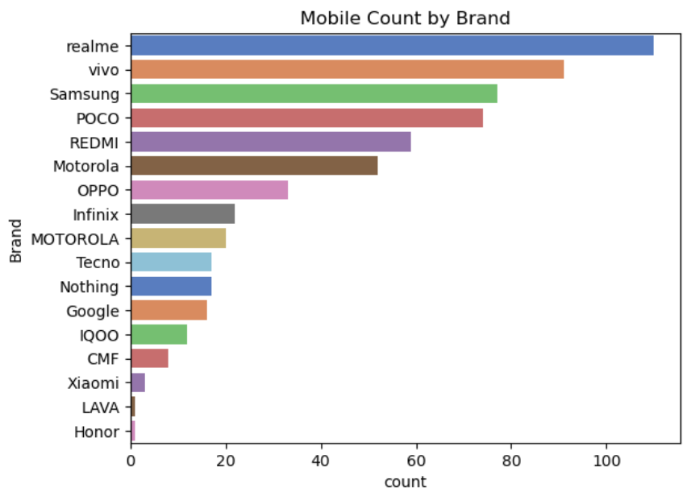
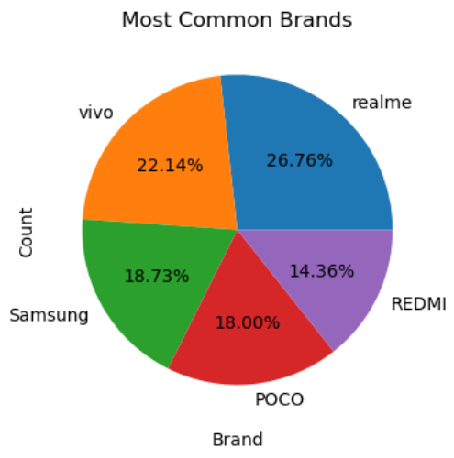
Univariate Analysis
Insight:
Brands like Realme, Vivo and Samsung have the highest number of listed mobiles.
This shows their aggressive product portfolio and strong market presence on Flipkart.

Slide 9
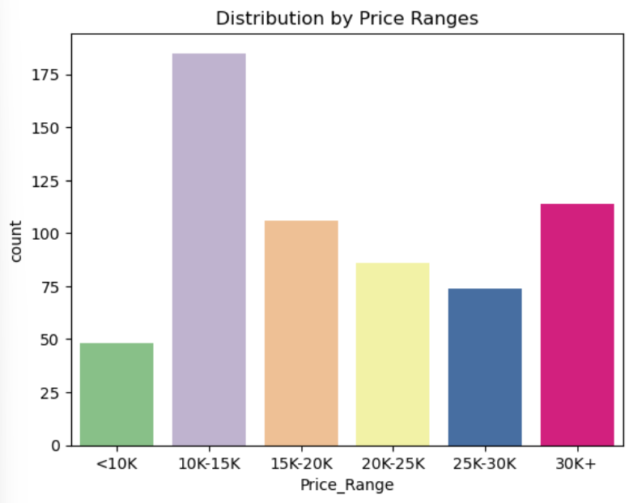
Univariate Analysis
Insight:
Most mobiles fall in the ₹10,000–₹20,000 price range, indicating this segment is the most competitive and customer-focused.
Premium segments have fewer products

Slide 10
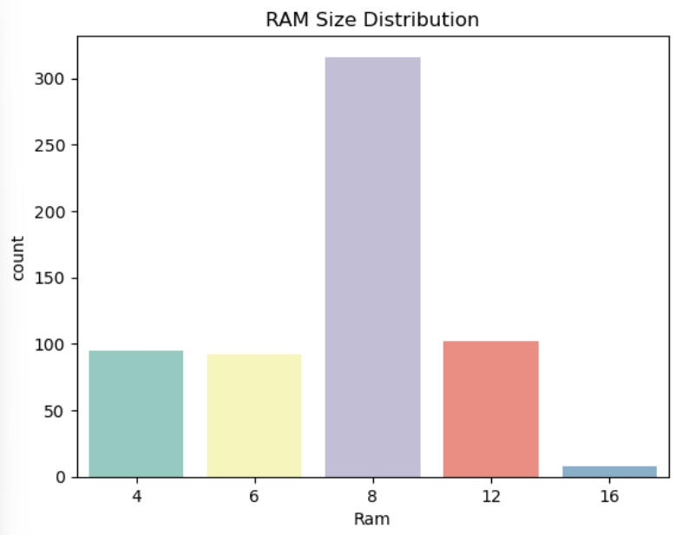
Univariate Analysis
Insight:
Most mobiles come with 8 GB RAM, making it the most popular choice.
4 GB, 6 GB, and 12 GB variants are also common, while 16 GB is rare.

Slide 11
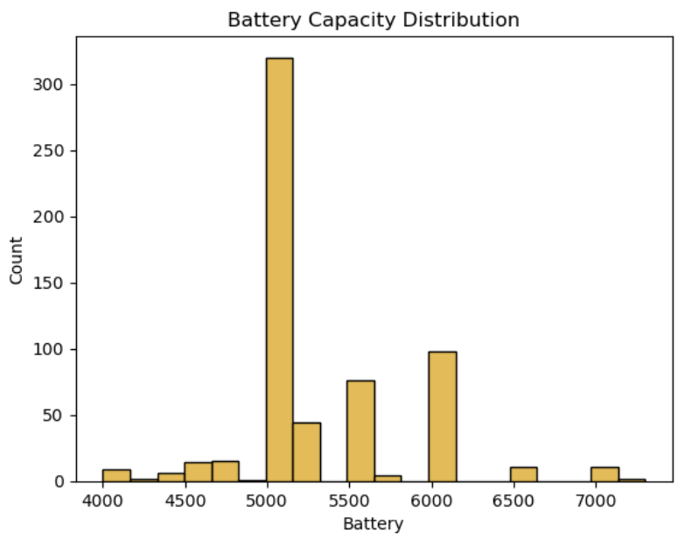
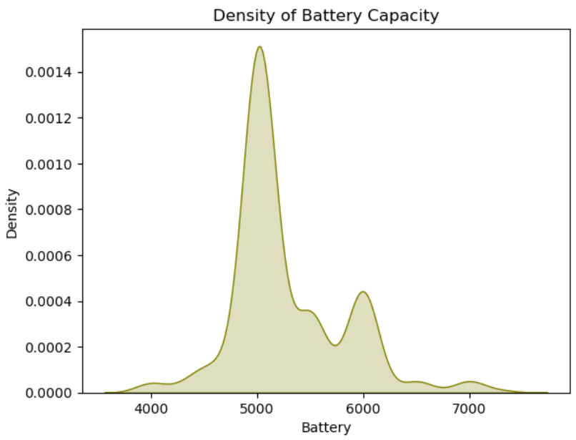
Univariate Analysis
Insight:
Most mobiles have a 5000 mAh battery, showing it is the standard choice.
Higher capacities like 6000 mAh are also popular, but less common.

Slide 12
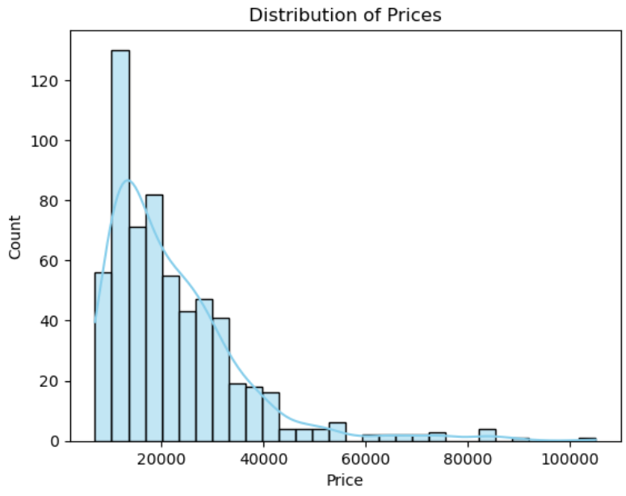
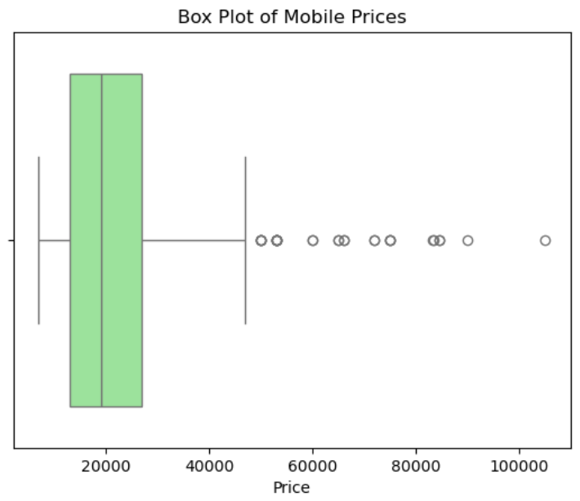
Univariate Analysis
Insight:
Most mobiles are priced below ₹30,000, making them affordable for the majority.
Very few models are priced above ₹50,000, showing high-end phones are limited

Slide 13
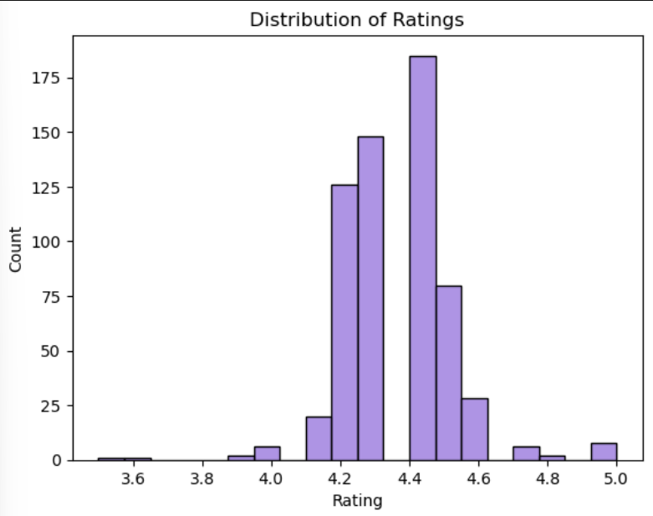
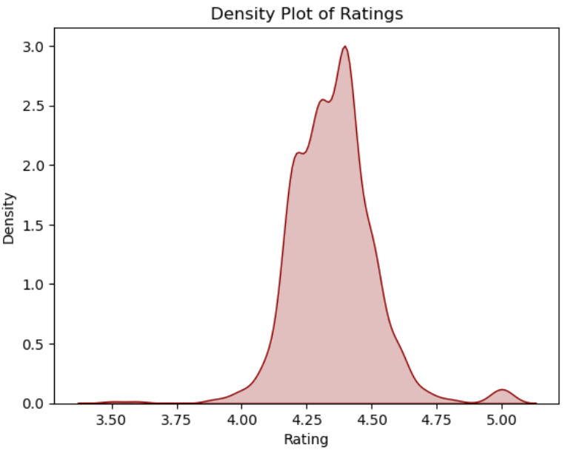
Univariate Analysis
Insight:
Most mobiles are rated between 4.2 and 4.5, showing high user satisfaction.
Very few phones have ratings below 4.0 or above 4.8.

Slide 14
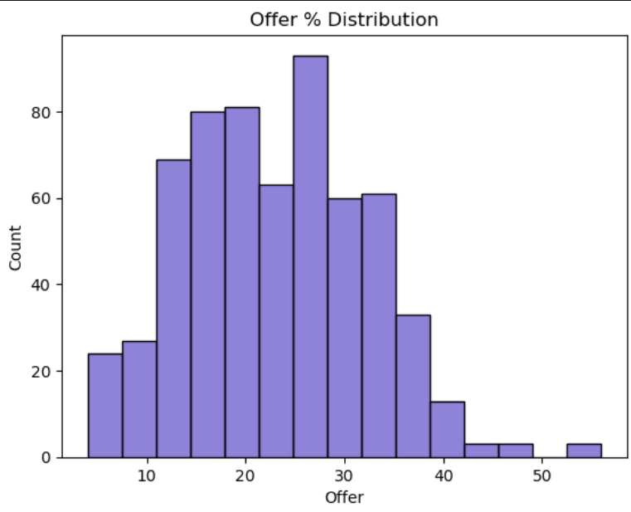
Univariate Analysis
Insight:
Most mobiles have offers between 15% and 35%, with 25% being the most common.
Very few products have discounts above 40%.

Slide 15
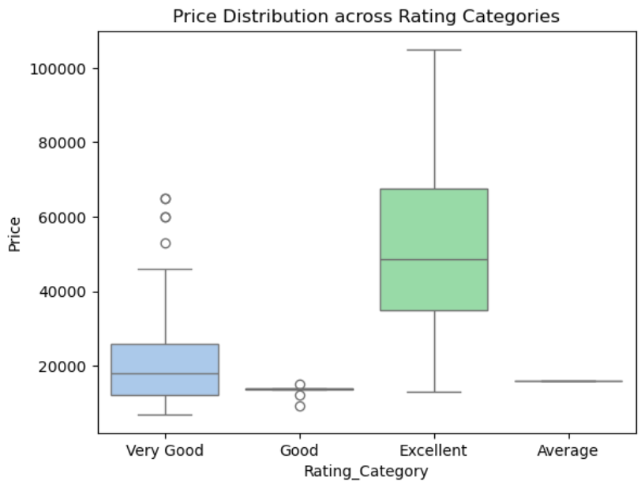
Bivariate Analysis
Insight:
Mobiles with 'Excellent' ratings have the highest price range, showing that top-rated phones are mostly premium.
'Good' and 'Average' rated phones are priced in the lower range.

Slide 16
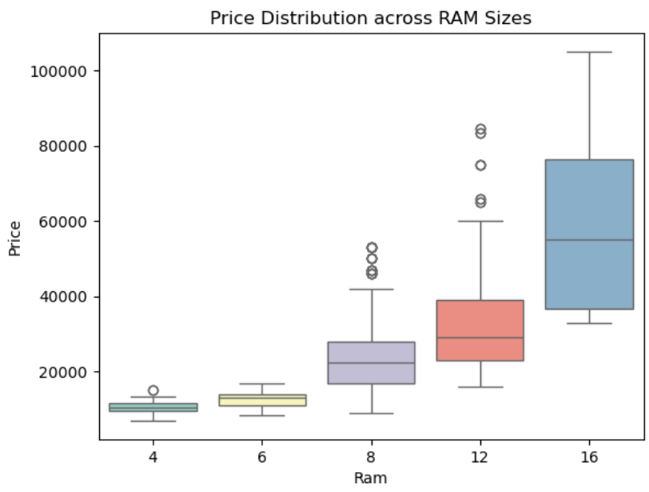
Bivariate Analysis
Insight:
As RAM size increases, the price also increases, indicating higher RAM is found in premium phones.
16 GB RAM mobiles are the most expensive, while 4 GB models are the most affordable

Slide 17
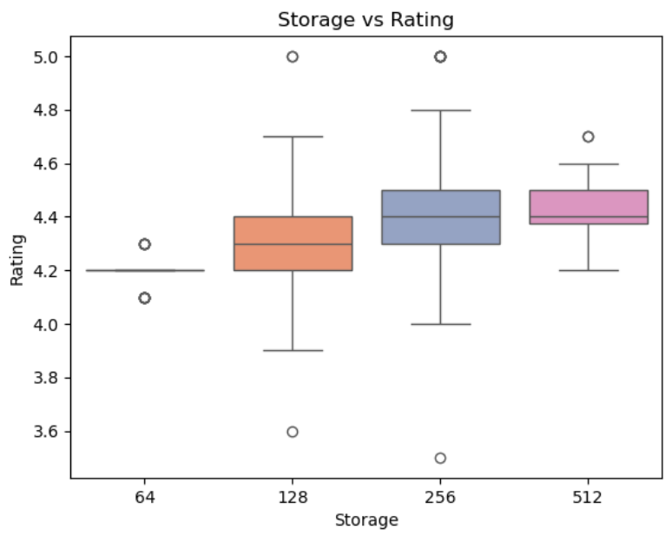
Bivariate Analysis
Insight:
Phones with higher storage (256 GB and 512 GB) generally have better ratings.
64 GB models have the lowest and most consistent ratings

Slide 18
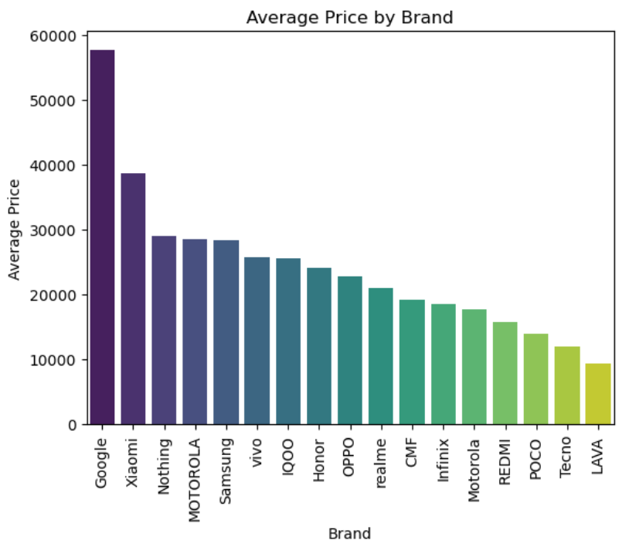
Bivariate Analysis
Insight:
Google and Xiaomi offer the most expensive phones on average.
LAVA, Tecno, and POCO provide the most budget-friendly options

Slide 19
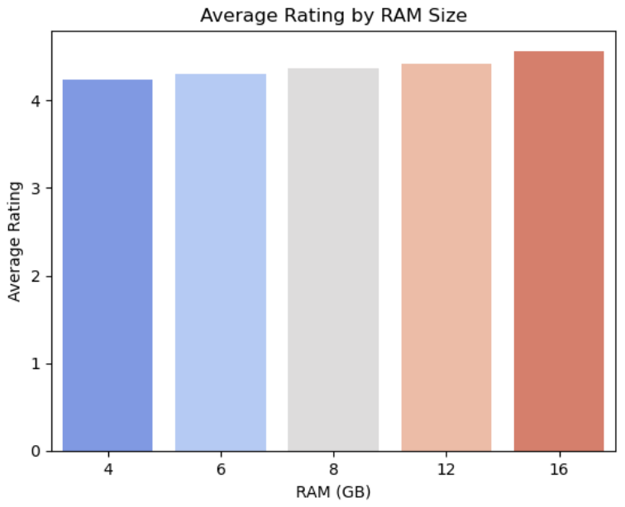
Bivariate Analysis
Insight:
Average rating increases with RAM size, with 16 GB RAM phones having the highest ratings.
This suggests users prefer better performance and multitasking

Slide 20
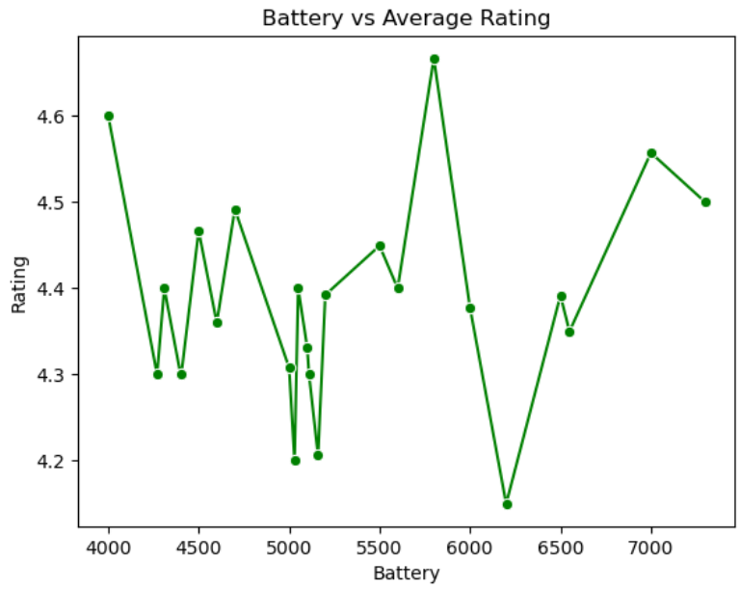
Bivariate Analysis
Insight:
There is no consistent correlation between battery capacity and average rating.
While some phones with larger batteries (6000–7000 mAh) have high ratings, others with moderate capacities (4000–5000 mAh) also perform equally well.
This suggests that battery size alone doesn't drive customer satisfaction

Slide 21
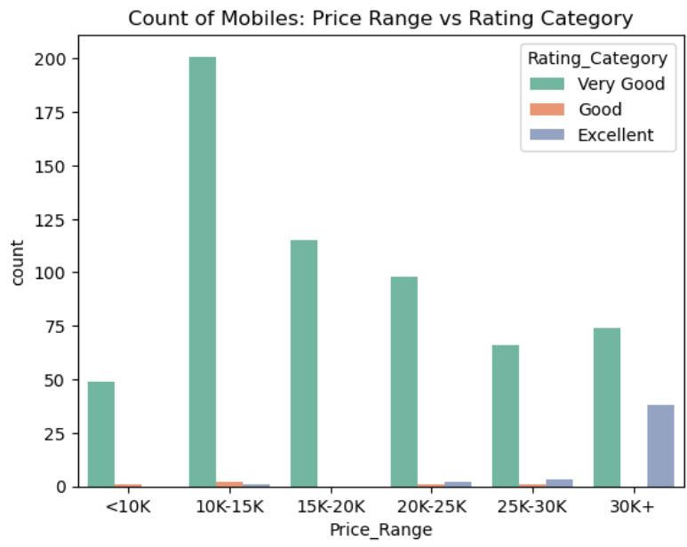
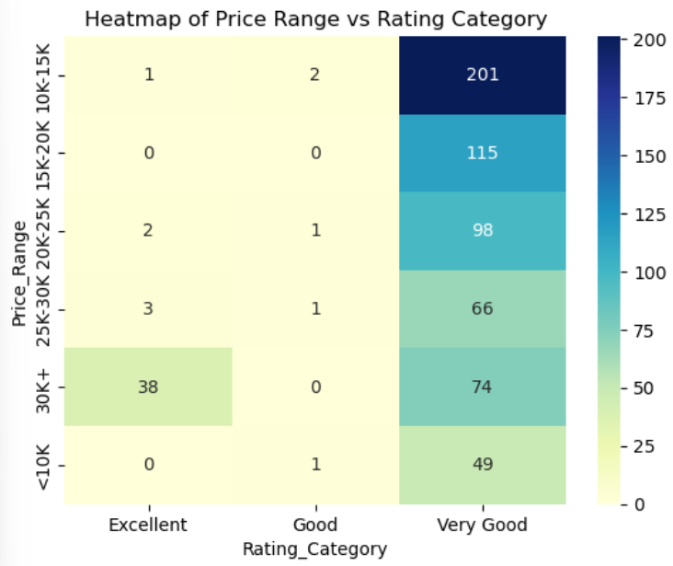
Bivariate Analysis
Insight:
₹10K–₹15K price range has the highest number of mobiles, most rated as "Very Good“
Premium mobiles (₹30K+) have fewer models but the highest count of "Excellent" ratings
Budget and mid-range phones are popular but rarely rated "Excellent"

Slide 22

Conclusion
Brands like Samsung, Xiaomi, and Realme dominate in volume.
Mid-range mobiles (₹10K–20K) have the highest variety and competition.
Higher RAM and battery specs generally align with better ratings.
Discount offers are common, but not always tied to better customer reviews.
Some brands consistently offer more value (specs vs price)

Slide 23

Project Experience & Key Challenges
🔹 Web Scraping Challenges:
Dealing with changing HTML structure and deeply nested product data on Flipkart.
Extracting clean information from unstructured text using regular expressions.
Handling missing values and inconsistent entries across 200+ pages.
🔹 Data Analysis Challenges:
Standardizing features like battery, RAM, camera, and storage for analysis.
Managing large volume of scraped data and transforming it for visualization.
Grouping and comparing ratings meaningfully across different price segments.
🔹 Key Takeaways:
Gained hands-on experience with BeautifulSoup, Pandas, and Seaborn.
Learned to build insights from real-world, messy datasets.
Strengthened our problem-solving and teamwork during debugging and cleaning.

Slide 24



